Slide 1
Team Roos- GTA Application Portal
Seth Emery
Blake Lord
Brandon Piotrowski
Ryan Borland

Slide 2
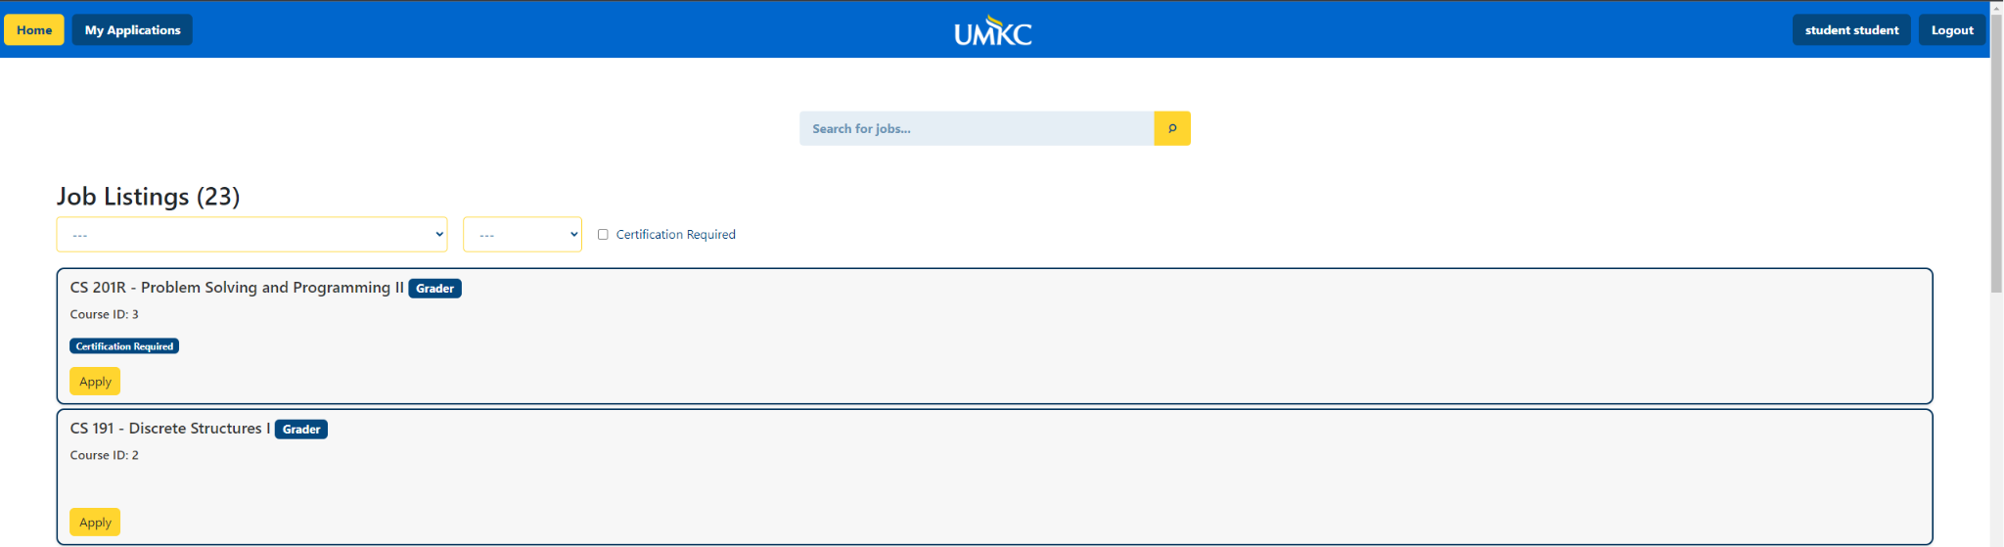
Overview
GTA Application Submission Portal
Notes:
A website we created for students to submit job applications for grader and lab assistant positions.

Slide 3



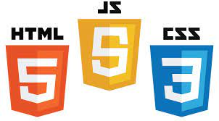

Technologies
Languages
Frameworks
Database
Notes:
The primary languages used where python, html, javascript, and css as we all had some experience using these languages
Our web development framework that we used was Python’s Flask framework and bootstrap for additional front end features
-We chose these frameworks as we all were interested in learning about them since companies such as Netflix and Lyft use them in their tech stack
The database we used was SQLite as it provided a simple way for us to work with a database as a team and maintain consistency
-Is also extendable for larger amount of users

Slide 4
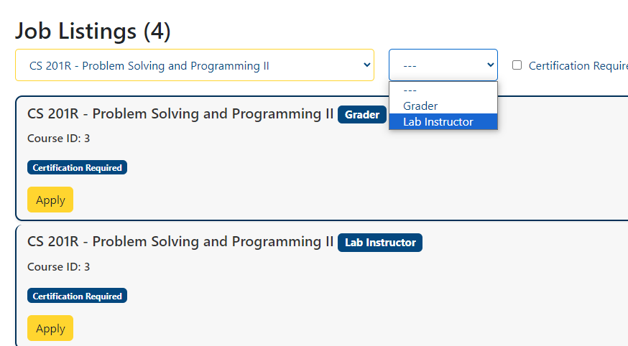
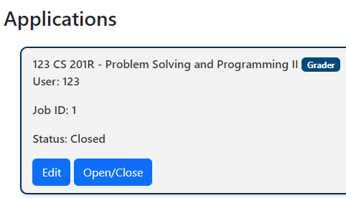

Functional Requirements
Application Collecting
Job Filtering/Search Bar
Admins can open/close applications
Students can modify their applications
Notes:
The requirements that we fulfilled were making it a web-based application that can collect applications online. The application provides a way for applicants to filter specific jobs by class, position type, and certification requirement. This includes the drop down menus and the search bar.
Admins are able to open and close applications as well as enable editing of student’s previously submit applications.

Slide 5
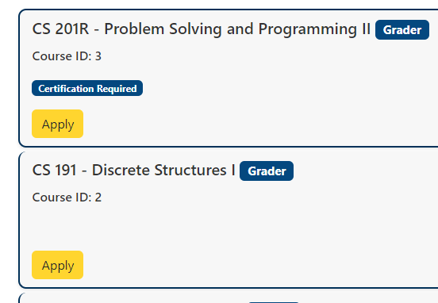
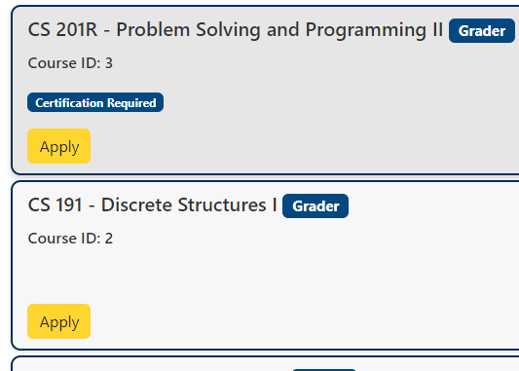
Prototype Feedback Modifications
Before
After
Card borders no longer clip
Notes:
One of the modifications we made after our prototype demo was fixing the borders of our card layout. Since these cards are stored as list items in an unordered list, we fixed the clipping borders by adding an empty div to the loop that generates the cards. This helps give a more appealing look to the website

Slide 6
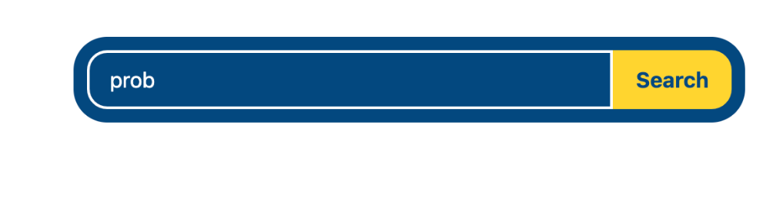
Prototype Feedback Modifications
Before
After
Updated search bar appearance
Notes:
Another modification we made after the prototype demo was improving the look of our search bar. We made it appear closer to the ones on the UMKC website which also gave it a more modern and minimalistic feel.

Slide 7
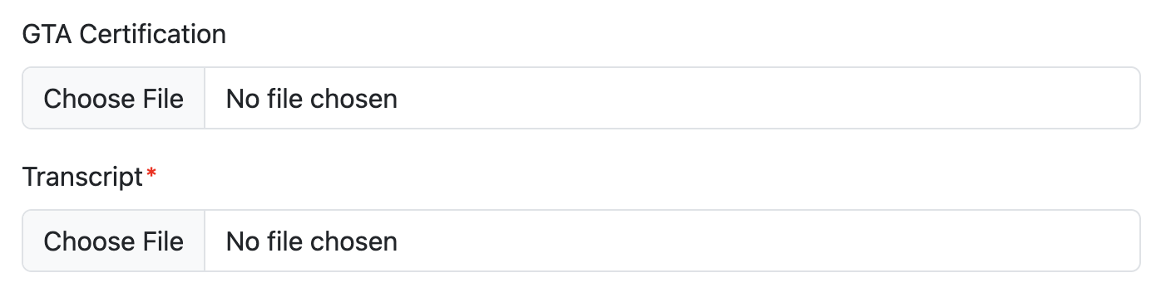
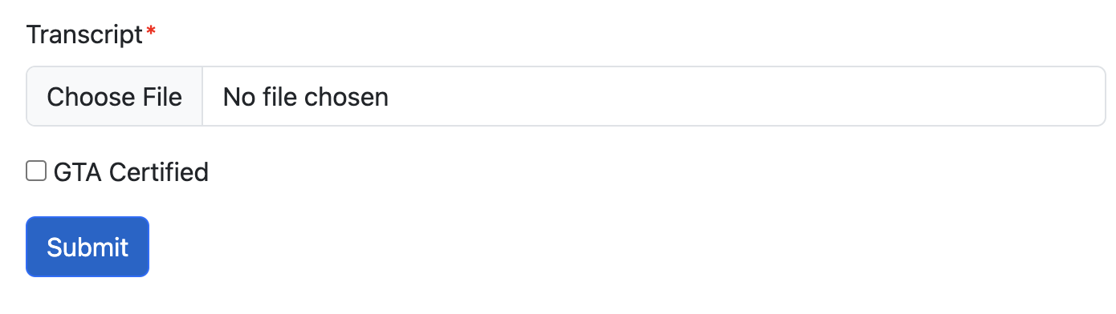
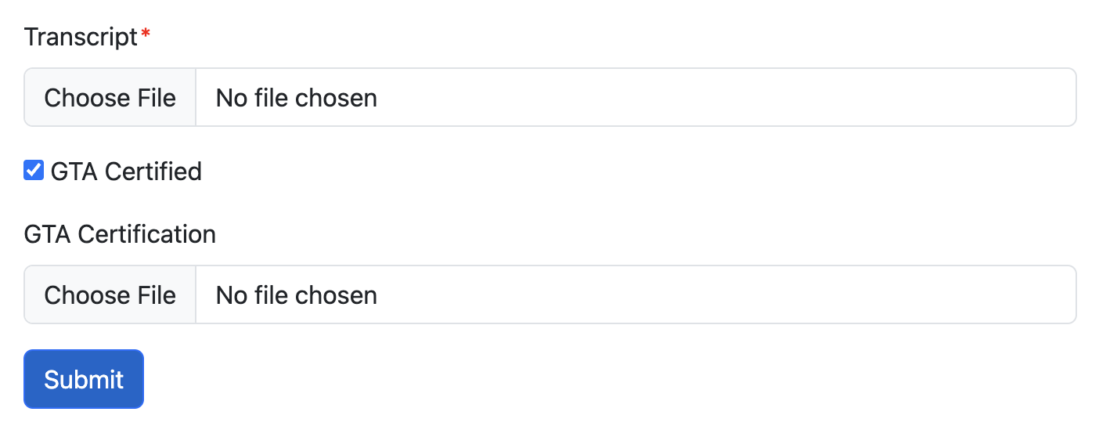
Prototype Feedback Modifications
Before
After
Changed application file submission
Notes:
Another modification we made after the prototype demo was improving the look of our search bar. We made it appear closer to the ones on the UMKC website which also gave it a more modern and minimalistic feel.

Slide 8
User Interface
UMKC color palette
Simple and concise page elements
Commonly used web page design practices
Easy navigability
Notes:
Our UI appearance follows man design element of the UMKC website. It has the same color palette as UMKC.
We made sure to have all the elements on the page be as self-explanatory as possible to improve the ease-of-use for the user.
The layout of the web page follows similar design patterns to many other websites to make it have a familiar feel of use. Things like the user account and login/logout button being in the top right, and having other navigation features be on the top left.

Slide 9
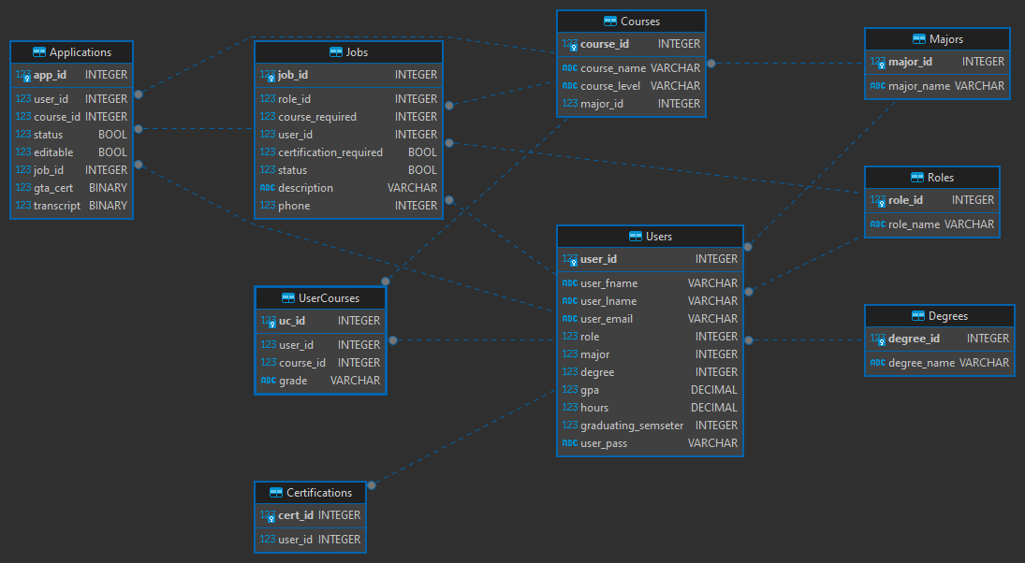
Database Layout
Data was stored across the tables: Applications, Certifications, Courses, Degrees, Jobs, Majors, Roles, UserCourses, and Users.

Slide 10
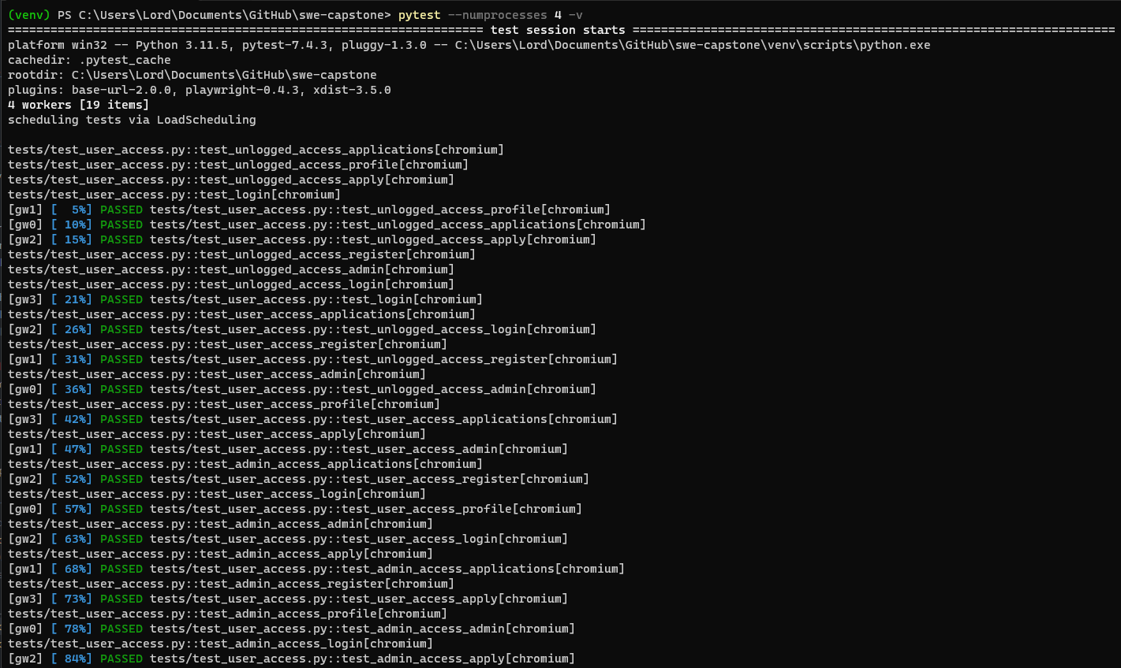
Testing
Testing uses a combination of PyTest for the unit testing framework and Playwright to handle GUI interaction for headless testing.
Will cover user access, button interaction, and form data input.

Slide 11
Learning Outcomes
More experience with full stack development
Database integration
Flask framework
Working on a larger project within a team
Notes:
Discuss the experience gained from having to ensure that the back end and front end work with each other.
If there were any troubles integrating SQLite with our website.
How you feel about the flask framework as a whole/your experiences with it.
And overcoming communication and organizational issues while working within a team

